Slide 1
NZISM August 2019 Philip Aldridge
Notes:
Agenda
A bit about HASANZ
Key current and future projects
The Future
What is means for you

Slide 2
Taskforce’s findings about the H&S workforce
“Limited availability of expert advice”
“Lack of standard competence or qualification levels a key contributor”
“Variable approaches to and quality of advice”
“….better accreditation standards are needed…”
Notes:
We have a huge capability and capacity problem in New Zealand n terms of our health and safety workforce.
Independent Taskforce on Workplace Health and Safety (2013). During the consultation that it undertook as part of its investigation, the Taskforce found that advice from external health and safety advisors and other professionals is of variable quality and approaches, and that there is limited availability (supply) of expert advice from health and safety professionals. The lack of any requirement to meet standard competence or qualification levels before professionals can offer their services was seen as a key contributor to the lack of quality advice.
The Taskforce also noted that, with the exception of medically trained professionals (e.g. nurses, doctors, Occupational Therapists and physiotherapists), registration is not compulsory. In addition to this, many health and safety advisers operate outside any registered professional body, thus avoiding all requirements to demonstrate qualifications or competencies.
“Concerns were raised about the quality and availability of external health and safety advice.
There is a high degree of variability among consultants in terms of their approaches, methods, competence levels and risk tolerances.
It was noted that there is no standard competence level or qualification set required for consultants.”
Survey we did with PWC. Roughly half the people working as H&S advisors and consultants have qualifications.
Govt H&S Lead
Less than half (46.15%) of respondents hold a tertiary level health and safety qualification,
Most respondents (75%) have moved into health and safety from a previous career
50% of respondents have been in their current role 5 years or less
The taskforce wanted one organisation that could represent all the disparate group.
WorkSafe helped setup HASANZ

Slide 3
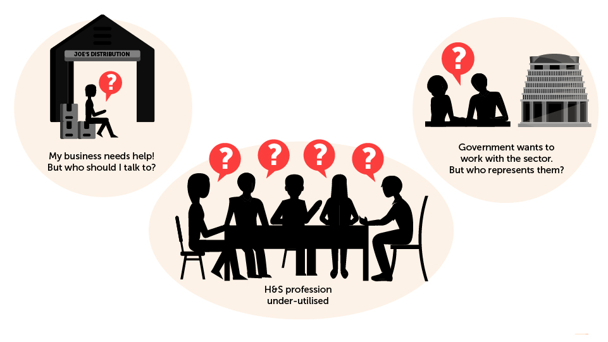
HOW WE WERE AS A PROFESSION
Notes:
The issues HASANZ was created to address
The taskforce identified a specific issue with quality, capability and capacity of the NZ H&S professions.
Businesses were also at fault as leadership was not generally focused on health & safety and they couldn’t easily find good H&S advice
And businesses certainly did not understand the nuance of different types of H&S specialist professions or capability
The task force found that many companies were receiving advise from people without qualifications or capability, often just replicating information from others and over charging, which undermined trust in the industry
Also, health & safety advisors often “fell into their roles” rather than selecting H&S as a chosen career path. As a result some did not upskill and obtain the requisite qualifications.
Large organisations have found it difficult to get high quality H&S advisors for Exec positions and often import them
Government were finding it difficult to know who to deal with and as a consequence did not engage with the professions
Recent research has helped us understand that 50% of advisors are over 50 and over 50% lack qualifications.
As a result (HASANZ) The Health and Safety Association of NZ was established end of 2014 to act as the professional body for all NZ H&S advisors

Slide 4
SPEAKING WITH A SINGLE VOICE
Notes:
Slide 3:
KEY MESSAGES
The research and report cover 7 disciplines
Generalists
Occupational Hygienists
Hazardous Substances Professionals
Ergonomists / Human Factors Professionals
Occupational Therapists
Occupational Health Nurses
Occupational Health Physiotherapists
A non profit
Collaborative and focusing on a number of System levers
Slide 6: Focusing on sorting out ourselves, so we spoke with one voice
HASANZ is as a system level player, not a membership based association.
Our vision is to address NZ’s H&S advisor capability and capacity and to better link our professions to business and government
We’re assisting to lift the bar on the H&S profession. Providing clarity and having people aspire to the profession

Slide 5
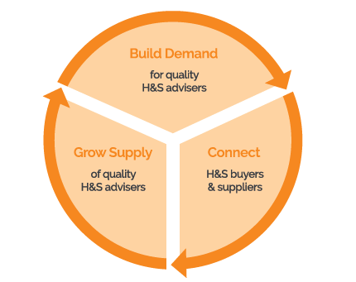
THREE KEY THEMES
Notes:
HASANZ was set up nearly 5 years ago to lift capacity and capability in the H&S workforce.
It gave the various H&S professions - for the first time - a way that they can work together so they can magnify their impact and reach.
The first few years of its existence focused on building relationships and understanding how this organisation can best deliver for its member associations and for New Zealand.
That work was really important because if you are trying to take a whole lot of people on a journey it’s essential to know where you are headed and the best way to get there.
However, last year HASANZ shifted gear and we are now very much in delivery mode.
This delivery work is focused around three things that reflect HASANZ’S core purpose:
Growing the supply of capable H&S professionals
Building demand for qualified professionals
And connecting professionals with the businesses who need their services.

Slide 6
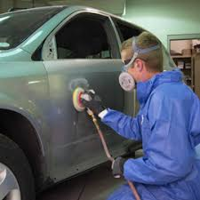
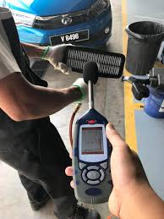
KEY AREAS
Grow business knowledge
Educating and stimulating the market
Voice into Government and the Minister
Advocacy and work on policy/direction
Workforce Development
Building capacity and capability
Utilising partnerships
PWC, Duncan Cotterill, Bus Leaders & Insurers

Slide 7
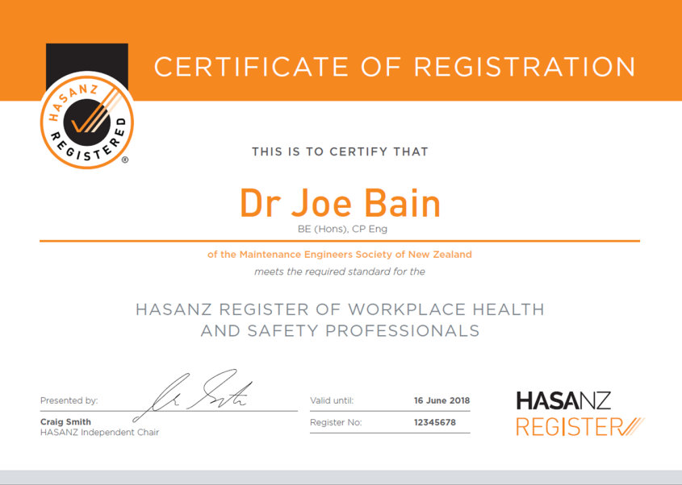
A register for workplace H&S professionals
Improve the quality of Health and Safety advice to business
Over 160 people on the register. Another 40 in the pipeline
Over 100 categories covering areas like noise, manual handling, fatigue, mental health, slips/falls & stress
Professional recognition of individuals (like engineers)
Backed by a code of ethics, insurance and complaints procedures
https://register.hasanz.org.nz
Notes:
Launch two months ago
Connecting business with H&S people.
Registered professionals may use the HASANZ Registered quality mark
Professional recognition of individuals (like engineers & accountants)
Grow awareness that H&S is a profession
Show a Career Pathway
Reduce the level of advice to businesses given by low skilled people
Code of Ethics, insurance and complaints procedures
On-going CPD
Registered professionals may use the HASANZ Registered quality mark
HASANZ Registered quality mark has been trademarked to protect the brand

Slide 8
DEVELOPING A PIPELINE
DEVELOPING A PIPELINE
Notes:
Slide 7: Developing a pipeline.
Businesses are struggling to find good H&S people which is presenting the market a challenge
As I mentioned 50% of advisors lack qualifications and 50% are over 50 so our problem only get’s worse.
We’re in the process of completing a stock take, of both our professions and education which we’ll release shortly
This will give us a good evidence baseline to quantify the needs and develop projects
as an example, we presented a case for Worksafe to support the market development of our Occupational Hygienists. Worksafe have invested $500,000 over 3 years which we’re applying to a plan.
We’re thinking about where future H&S practitioners, professionals and specialists could come from – a pipeline.
Practitioners
Graduates from health sciences, engineering and other disciplines
People who want to come off the tools or want a 2nd career
Reformed injured who have a very personal passion
And my favourite long term opportunity – Health & Safety Reps who provide a great future pipeline opportunity
We’re also thinking about whether we have appropriate education capacity and capability so are thinking about this issue from an ANZ perspective
To address act as a catalyst to support our pipeline, we released a scholarship program in Sep-18. We came up with the idea, quickly raised $250,000 for a 2 year program and asked for applications for 12 scholarships. We received over 100 applicants and ended up appointing 19 scholarships.
Qualifications is only part of this puzzle so we’ve also included field trips and mentoring and are exploring graduate program options
This year we supported diplomas for practitioners and post grads, however in the future we’ll also be supporting applied research and focusing on our vulnerable areas such as Maori and Pacifica people.
We’re very ambitious, so we’re now out fundraising and think we could really make an impact to H&S advisor capability and capacity in NZ if we provided 30-40 scholarships per year for 10 years. We think, given the marketing and awareness raising, many more would migrate to H&S as a great career option and think we could have 1,000 people + engaging in H&S career development over 10 years. Depending on fund raising success of course.
We think this program could really make a difference to business advice and outcomes for our workers

Slide 9
Scholarship, Occ Hygienist and Haz Substances
Scholarship
1st Year we awarded 19 scholarships
General, post grad & Occ Hygienists, applied research and Maori
Applications open now (close 3 Sept)
Specific Sector Related Projects
Growing the number of Occ Hygienists
Building the number of Hazardous Substances professions
Notes:
General – wanting to do a diploma or degree in Occ &S
Post graduate – those wanting to undertake post grad study
Raised $250K last year. Aiming for $1M this year
Potentially
Applied research. ACC is keen on that. Masters and PhDs For example, fatigue in the transport sector
Maori and Pasifika
Hats off to those organisations which had the foresight to get behind the HASANZ Scholarship programme – we all know that education is the key to change.
Air New Zealand,
Z Energy,
Fonterra,
KiwiRail,
PwC New Zealand.
Treescape
SafetyApp.Pro,
Safe365

Slide 10
STOCKTAKE/PIPELINE PROJECT FINDINGS
Business don’t know what each discipline does
Not all disciplines have agreed competency frameworks
Substantial gaps in learning pathways and programmes. Often programmes are not based on a competency frameworks
Skills shortages. Most disciplines experiencing strong demand with big shortages in some areas
>50% people within 10 years (4,500 to 6,600) when the workforce is aging and the education provision is ‘’mixed’’
Notes:
Scope of the professions, and ensuring businesses know which professional to go to for help.
Competency frameworks – do they exist for all disciplines?
Education and development pathways – Can people get access to the training and development they need to meet competency requirements
Skills shortages and future demand – do we have enough people working discipline now and in the future?
Additional enabling recommendations – The report also includes some other recommendations to support improvements in capacity and capability.
Businesses do not fully understand what the various disciplines do.
They don’t know some disciplines exist or that to deal with some issues they might need to use several professionals.
As a result, they are confused about who to go to for support and there is a risk they will get suboptimal advice.
The disciplines themselves do not agree on who does what, where the boundaries lie.
Where overlaps and cross-overs in roles occur, there is not always mechanisms to support them to work together.
There are significant gaps in education and development pathways for many disciplines.
For some disciplines, there is no single course of study people can take at a New Zealand tertiary institution that will enable them to meet all the required competencies.
For small disciplines with low numbers of students it is not economical for tertiary institutions to run courses.
Tertiary institutions do not allow or support students to take papers from multiple universities in order to meet competency requirements.
Education and development are not being designed to meet competency frameworks
In some instances this is because there is no agreed competency framework
In other cases, courses aren’t always updated to reflect newly adopted or modified frameworks.
Danger of mis-match between what is taught and what is needed in the market
(For example, with the INSHPO framework for Generalists)
There is a lack of flexible, non-traditional learning pathways
This would diversity the reach of health and safety, meaning those who didn’t go to university could build the relevant competencies.
It would also provide an accessible pathway for health and safety representatives into some of the disciplines.

Slide 11
KEY RECOMMENDATIONS
Scope
Simple framework to describe each discipline (and interactions between them)
Tools/case studies for help business
Implement competency frameworks
Education / Development Pathways
New programmes (potentially from overseas)
Vocationally based pathways
Accreditation of providers
Skills Shortages / Future Demand
Attraction strategy
Guidance for business on hiring people
More support for mid-level professionals

Slide 12
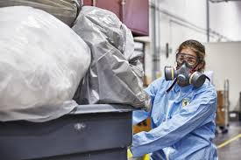
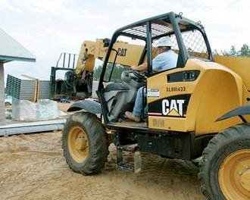
What is means for you?
We provide a direct line into WorkSafe and the Minister
A group focused on the overall system that is representing you
Initiatives to build the capacity and capability of the workforce
Growing and stimulating demand for qualified and skills H&S people
Feed your ideas and intelligence into NZISM
Work with other associations/groups
Notes:
What we are doing
What it means for you

Slide 13
Contact Details
Philip.Aldridge@hasanz.org.nz Lisa.Bridge@hasanz.org.nz Kathryn.Maloney@hasanz.org.nz Mia.Hradsky@hasanz.org.nz
Please drop into BERL House, Level 6, 108 The Terrace

